Slide 1
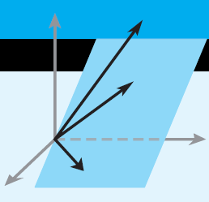
Elementary Linear Algebra
Howard Anton
Copyright © 2010 by John Wiley & Sons, Inc.
All rights reserved.
Chapter 5

Slide 2
Chapter 5
Eigenvalues and Eigenvectors
5.1 Eigenvalues and Eigenvectors
5.2 Diagonalization
5.3 Complex Vector Spaces
5.4 Differential Equations

Slide 3
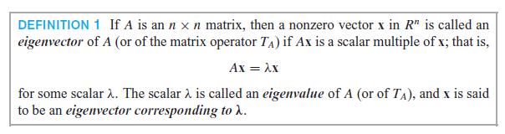
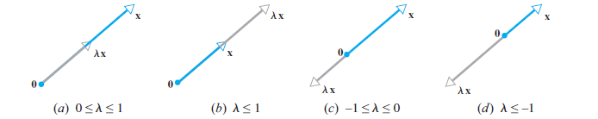
Section 5.1
Eigenvalues and Eigenvectors

Slide 4
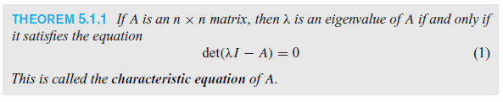
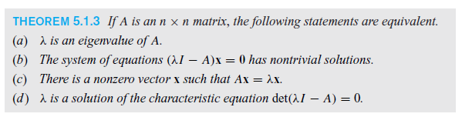
The Characteristic Equation

Slide 5
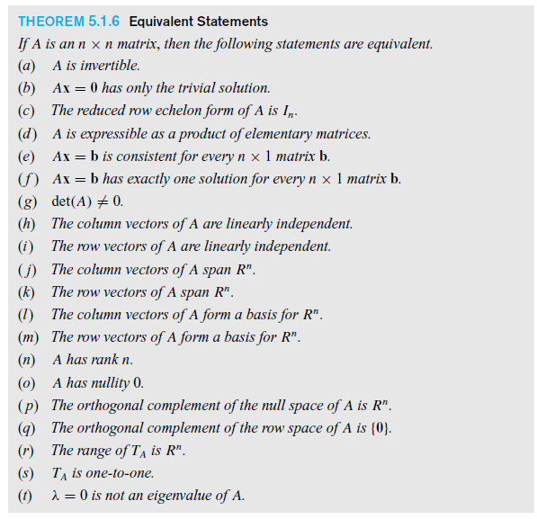

Slide 6


Section 5.2 Diagonalization

Slide 7
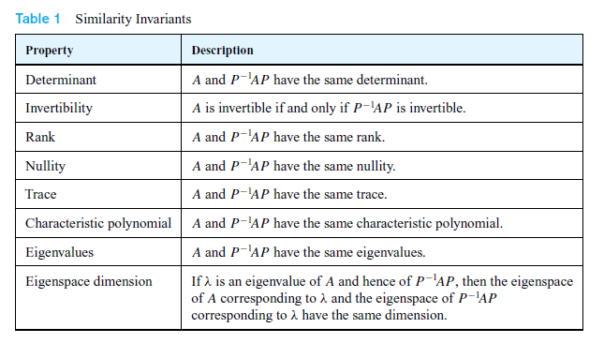
Similarity Invariants

Slide 8
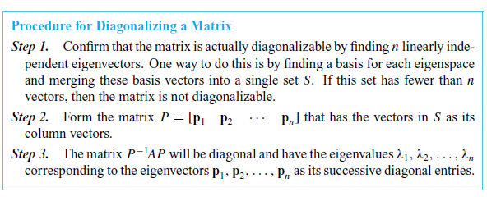
Diagonalizing a Matrix

Slide 9
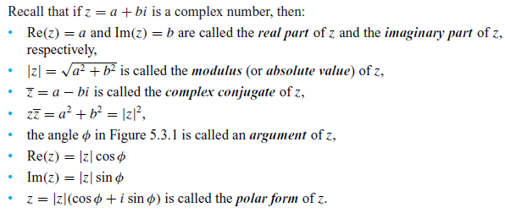
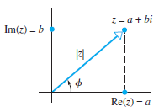
Section 5.3 Complex Vector Spaces

Slide 10
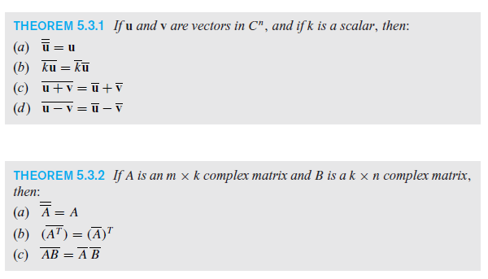
Algebraic Properties of the Complex Conjugate

Slide 11
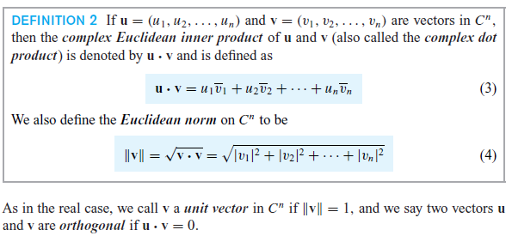
Dot Product and Norm

Slide 12
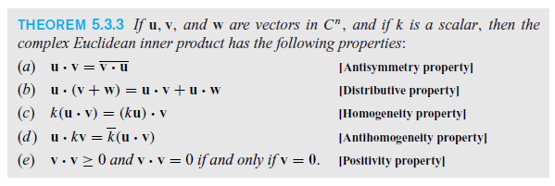
Properties of the Dot Product

Slide 13
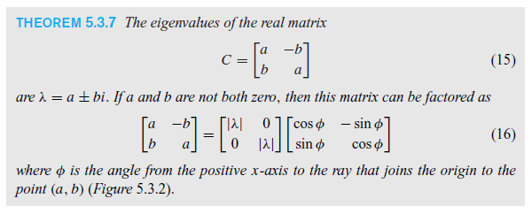
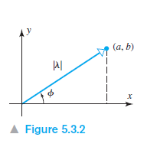
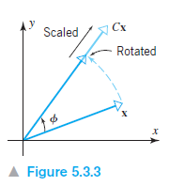
Geometric Interpretation of Complex Eigenvalues

Slide 14
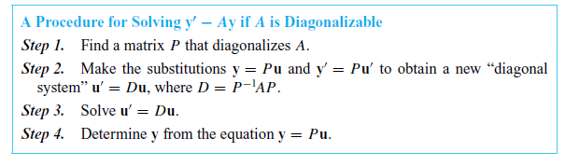
Section 5.4 Differential Equations

